Slide 1
Project
Aerial Robotics (Drone)

Slide 2
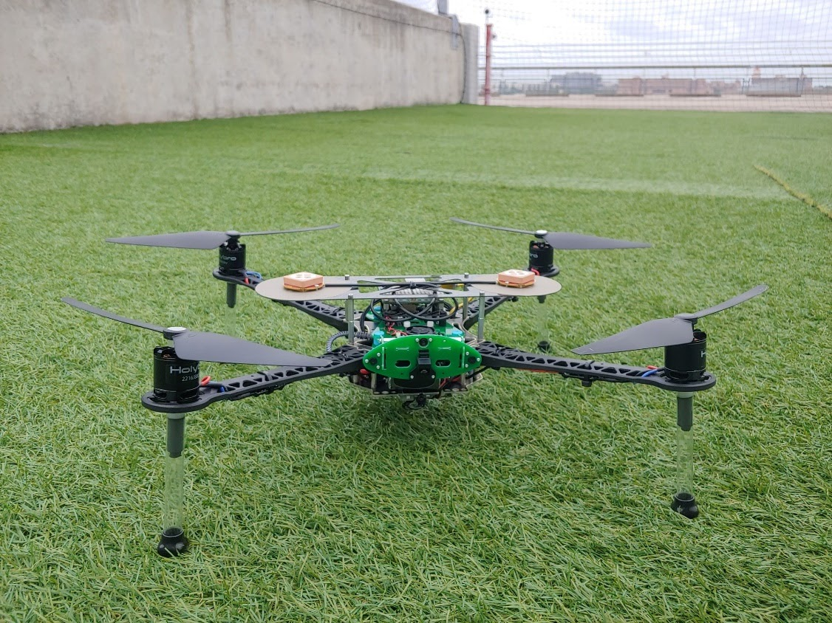
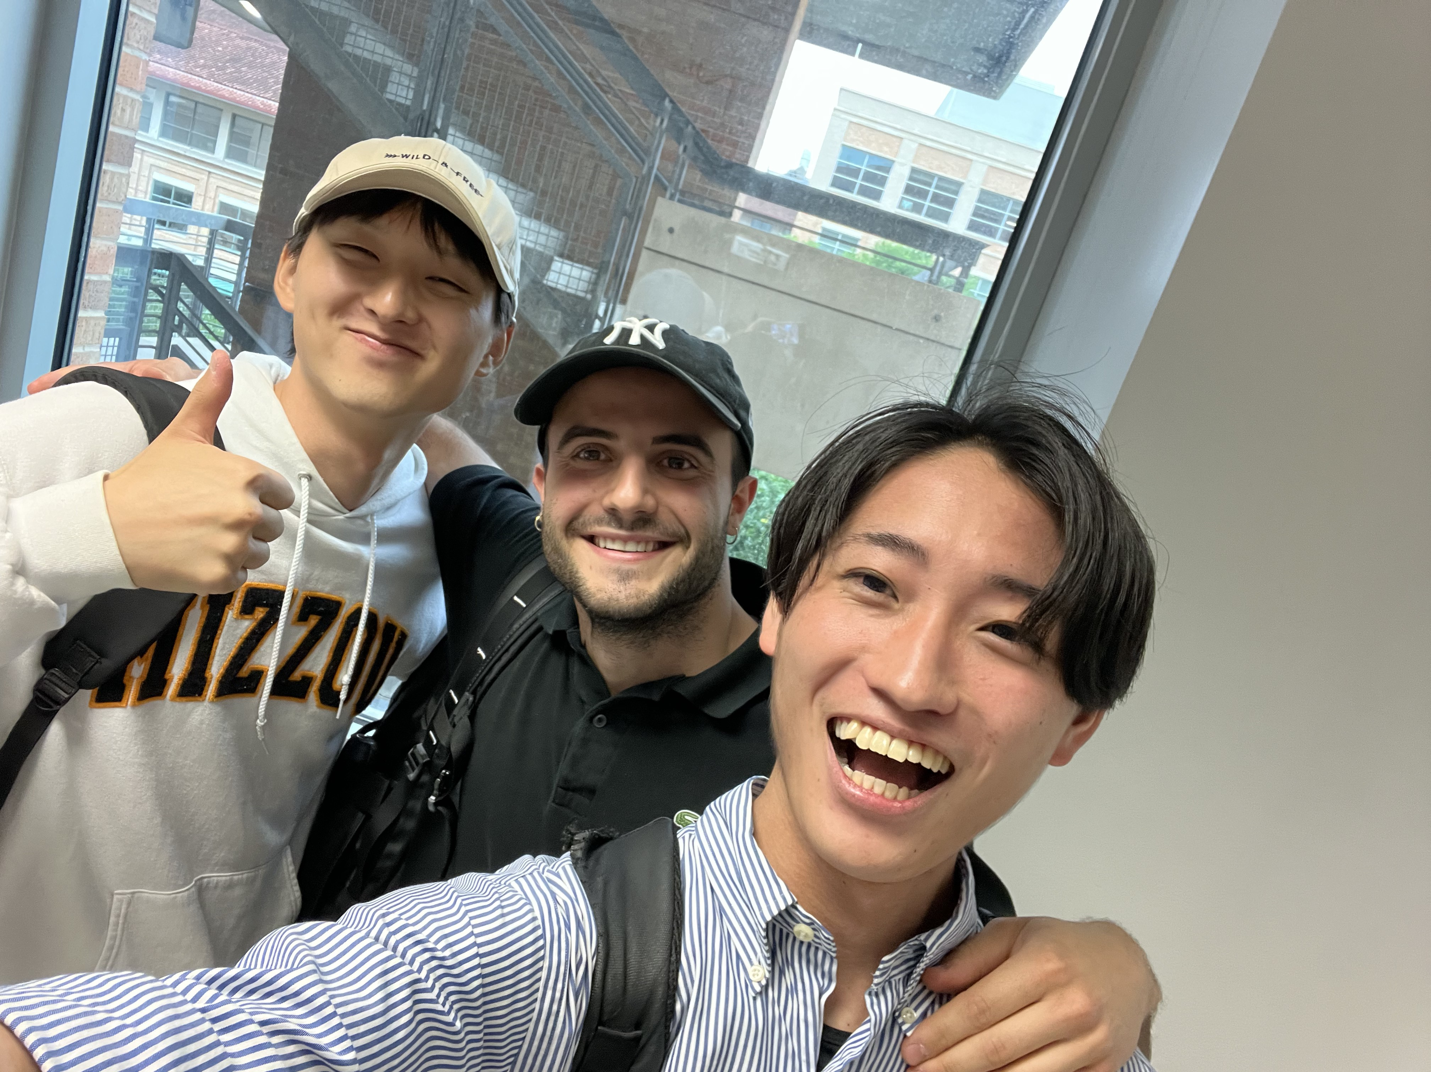
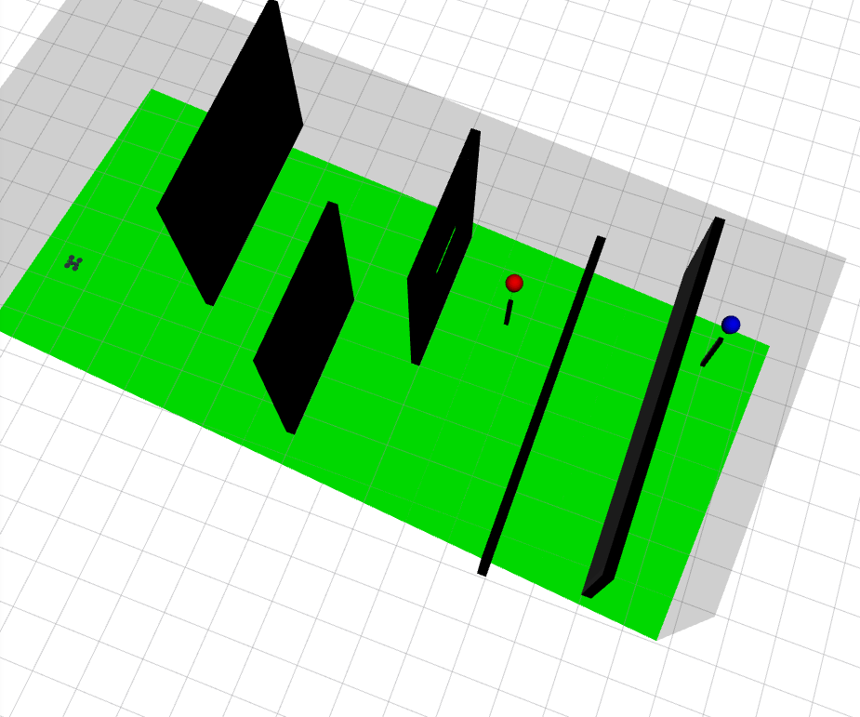
Aerial Robotics (Drone)
2024 Spring (Last Semester)
Team Competition
Goal:
Create an algorithm to find the fastest routes to predetermined targets
The final algorithm is implemented in a high-fidelity simulation tool
Source: ASE 497W Todd E. Humphreys; University of Texas at Austin
Notes:
The first project I want to present is the Drone project I did in Aerial Robotics course last semester. This was a team competition that consisted of three people per team. The goal was to create an algorithm for the drone that would find the fastest routes to targets. The targets were balloons placed on a field, which you will see soon. And the drone had to pop the balloons by flying through them to confirm that it reached the targets. There were also imaginary obstacles that the drone had to go around,and lastly the algorithm should have worked both in a simulation environment and in real life.
So for the competition, each team would timed on how fast it pops two ballons from a designated starting point and returns to another desginated end point.
Here you see a picture of the drone, or the quadrotor that we implemented our algorithm on. Here is a picture of my proud teammates!
For spoilers, We were one of the two teams that successfully flew the dorne in real life and ended up placing 2nd in the competition.
Before I begin explaining my work, I will start by showing the result of my team’s work together!

